Slide 1
HoDoMS Conference 2016
Thursday, 21st April
Designing and using informal learning spaces to enhance student engagement with mathematics
Jeff Waldock
Department of Engineering and Mathematics
Sheffield Hallam University

Slide 2
Informal Learning Spaces
HoDoMS 2016
Jeff Waldock
Context
SHU Maths quick facts ..
Subject group within a Dept. of Engineering and Mathematics
Currently 26 academic staff (21 FTE) + 6 ALs
BSc Mathematics since 1995
Practical applications, employability and student support
Optional sandwich year (no tuition fee)
Recruitment target: 100 (recruitment 2015: 129)
NSS since 2008: 89%, 95%, 100%, 93%, 95%, 96%, 96%, 99%
Guardian league table since 2011: 11th, 16th, 21th, 15th, 22th, 37th

Slide 3
Informal Learning Spaces
HoDoMS 2016
Jeff Waldock
Student engagement
Positive factors ..
Interest, motivation, passion, success
Understanding (course material, and purpose)
Building towards clearly-articulated graduate outcomes
Shared purpose, shared support, community culture
Negative factors ..
Lack of success
Lack of understanding (course material, and purpose) and ..
Lack of support available

Slide 4
Informal Learning Spaces
HoDoMS 2016
Jeff Waldock
Engagement factors relating to space …
a sense of belonging
being and becoming part of a professional community
“Suitably-designed open learning space facilitates staff-student and peer interaction by supporting new patterns of social and intellectual behaviour”
[Oblinger, 2005]
peer and tutor support
“Providing spaces where faculty and students can ‘run into’ each other increases engagement and learning”
[Hunley and Schaller, 2009]

Slide 5
Informal Learning Spaces
HoDoMS 2016
Jeff Waldock
Engagement factors relating to space …
Incorporating a disciplinary focus in the design helps learners identify with that discipline and feel they belong to a professional community;
This, together with a managed peer-support network, helps create a partnership learning community within which student engagement can flourish
[Boys, 2011; Healey et. al., 2014]
Community provides a feeling of a common purpose.

Slide 6
WHAT .. activities?
enabled by …
a working environment people want to use
Peer-Supported Learning – PSL/PAL
Meeting rooms, with white boards
Group work
Group working areas, with white boards
Individual work
IT-enabled: wi-fi, laptops, PCs
Social/professional activities
– e.g. Maths Arcade
3 “Expressions”
(social, professional, disciplinary)
Informal staff-student contact
Co-located staff offices
Open Learning Space
Out-of-hours access
Encourage interaction
A sense of belonging
staff  student
student  student
Create a professional learning community
… with a disciplinary focus
Keep learners engaged in course-related work between classes
active
collaborative
social
WHY

Slide 7
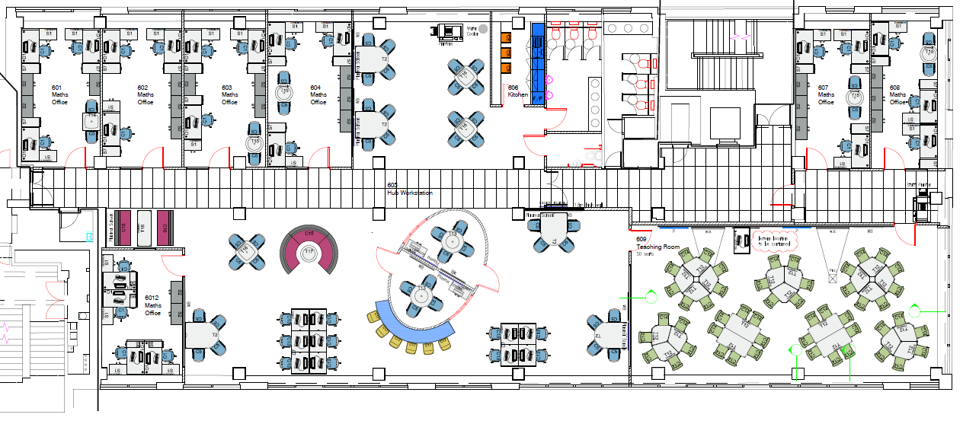
Informal Learning Spaces
HoDoMS 2016
Jeff Waldock
Sheffield Hallam University
Mathematics - Floor Plan
Six 3-person staff offices
One 4 person staff office
One 50 seat, IT enabled teaching room
Two small meeting rooms

Slide 8
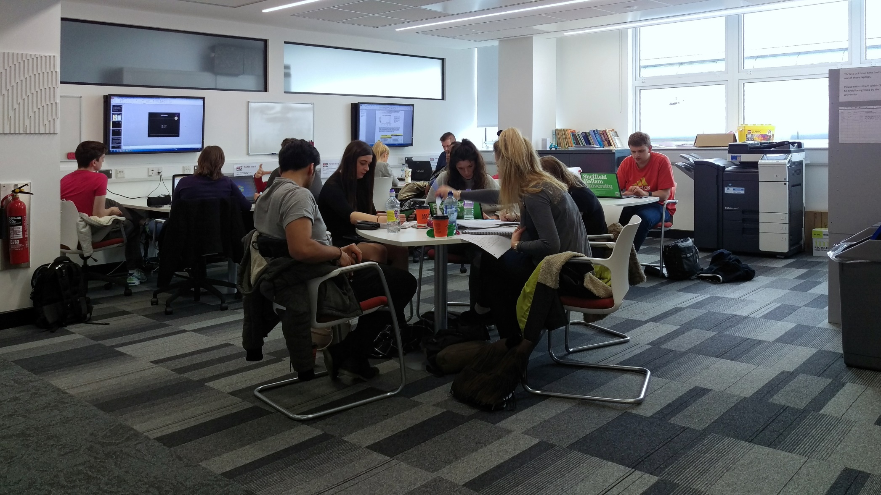
Informal Learning Spaces
HoDoMS 2016
Jeff Waldock
Group and individual working areas

Slide 9
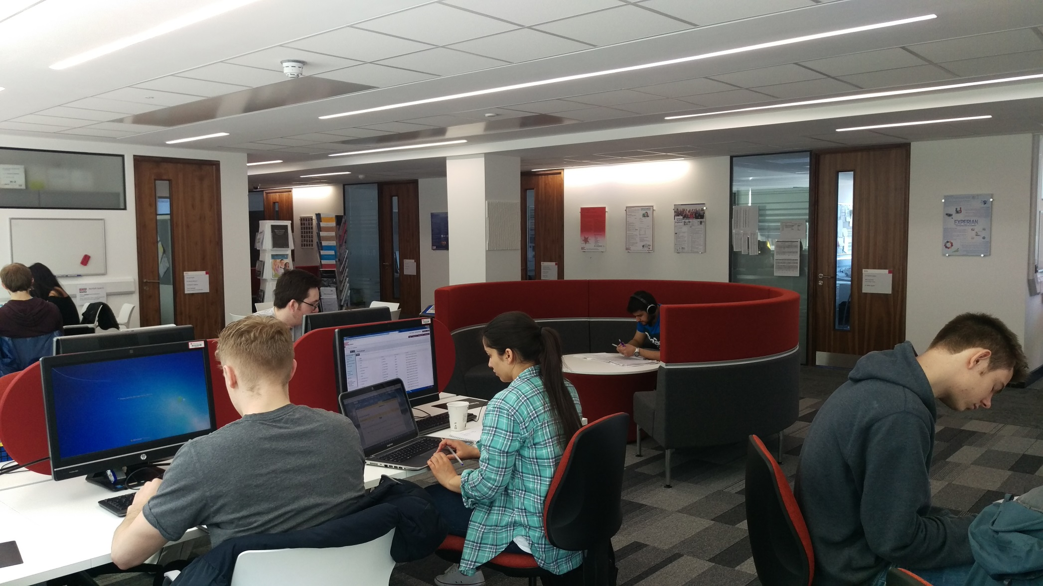
Informal Learning Spaces
HoDoMS 2016
Jeff Waldock
Group and individual working areas

Slide 10
Informal Learning Spaces
HoDoMS 2016
Jeff Waldock
Staff offices

Slide 11
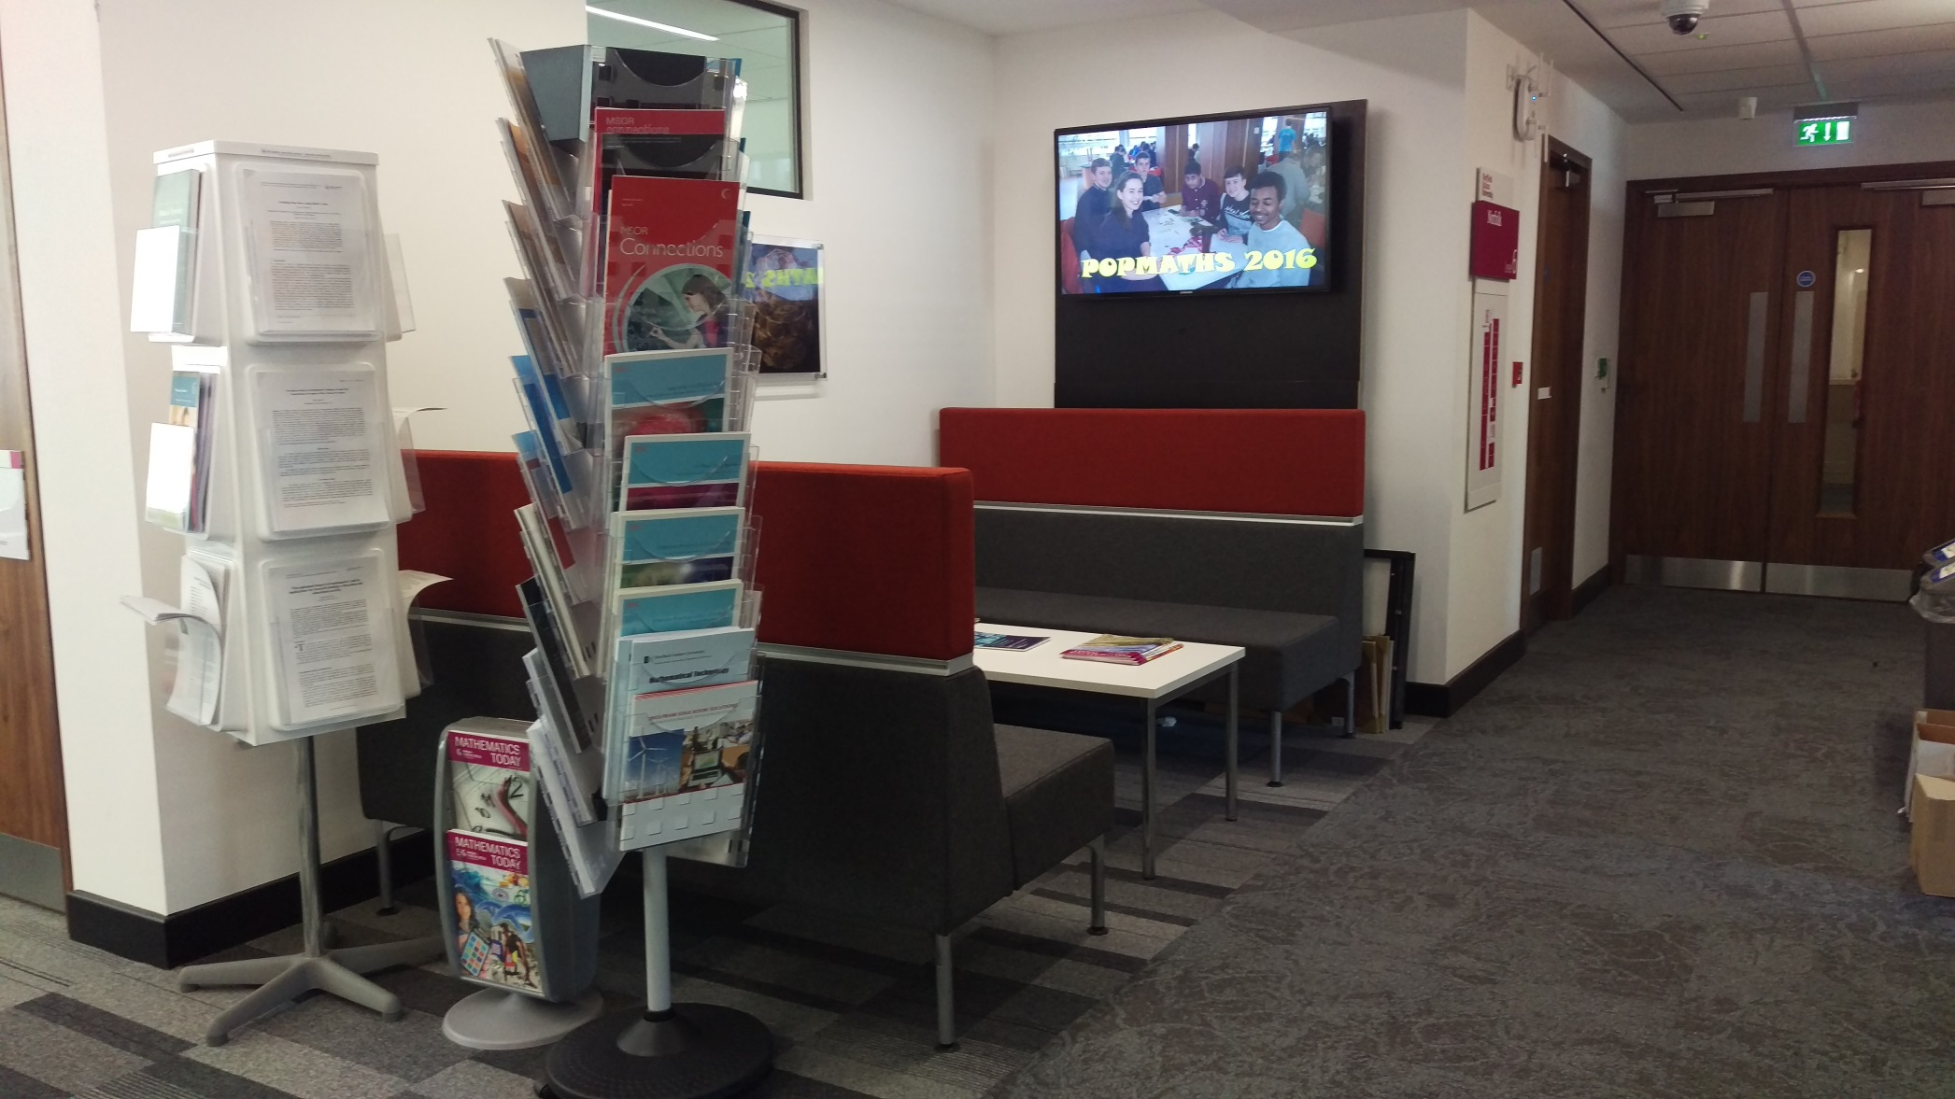
Informal Learning Spaces
HoDoMS 2016
Jeff Waldock

Slide 12
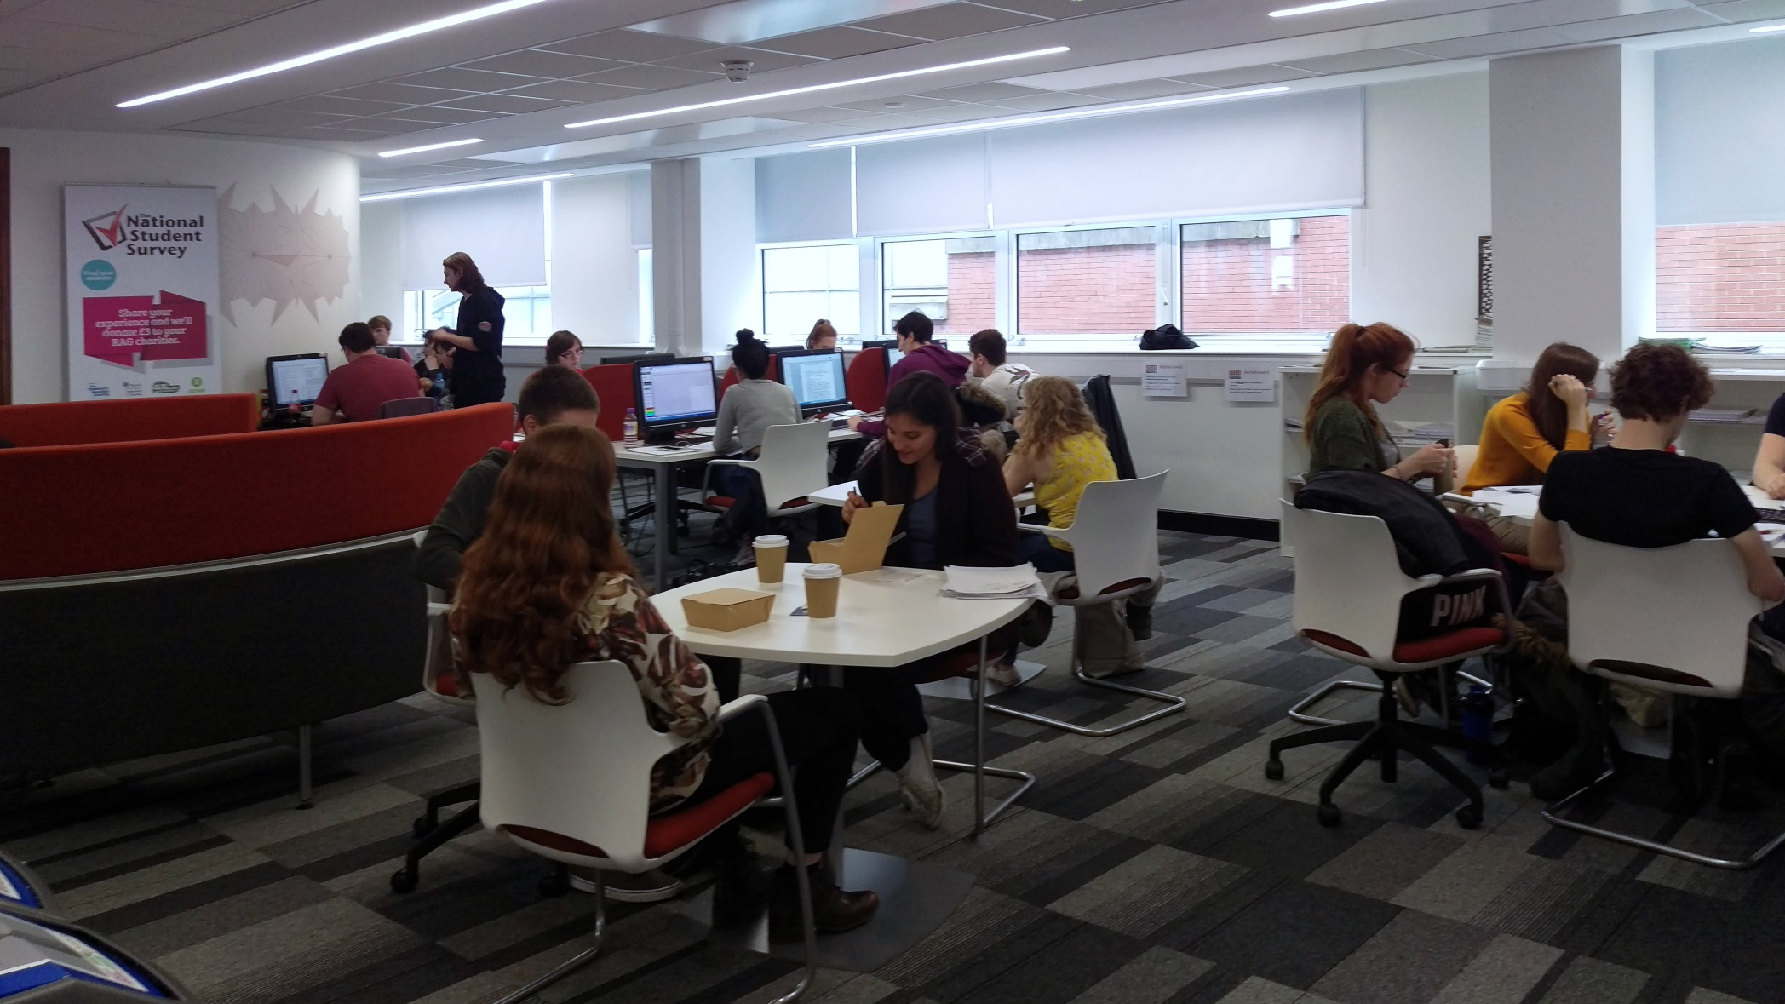
Informal Learning Spaces
HoDoMS 2016
Jeff Waldock
Group and individual working areas

Slide 13
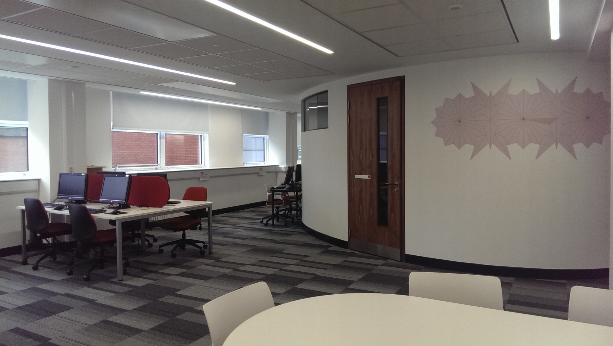
Informal Learning Spaces
HoDoMS 2016
Jeff Waldock
Meeting rooms

Slide 14
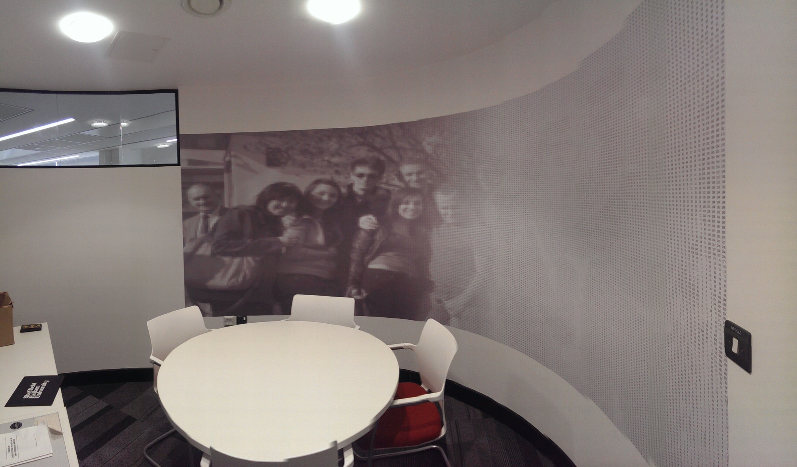
Informal Learning Spaces
HoDoMS 2016
Jeff Waldock
inside one of the meeting rooms

Slide 15
Informal Learning Spaces
HoDoMS 2016
Jeff Waldock
SURVEY (Spring 2015)
What do you feel the benefits are of this new space?
Is there anything you feel better able to do now compared to before?
What else should this space provide?
https://maths.shu.ac.uk/staff1415/poll/pollresults.php

Slide 16
Informal Learning Spaces
HoDoMS 2016
Jeff Waldock
Improved availability of staff
"Having such a wealth of knowledge just a knock away is brilliant - it is so much easier to approach staff than previously"
(second year)

Slide 17
Informal Learning Spaces
HoDoMS 2016
Jeff Waldock
Developing a community
"Having a home for the discipline makes the maths department seem more united" (final year)
"Working around people studying the same subject - a sense of 'home'" (second year)
"As the area is purely maths it is easier to find someone who also studies a module you do and promotes students to help one another and interact" (final year)
"There are always people to ask if you are stuck, even ask other years for help" (first year)

Slide 18
Informal Learning Spaces
HoDoMS 2016
Jeff Waldock
Facilitating work
"It's a very bright, open space with good modern features - three things for me that make working easier" (second year)
"Big round tables are excellent for team work and sharing ideas" (first year)
"White boards and PC TVs promote group work and problem solving" (first year)
"It is also open and tidy and I can think better in spaces like that. The meeting rooms and group booths are great for when you want to work with friends as well" (second year)
"It's conducive to group work since there are tables we can huddle around and white boards" (final year)

Slide 19
Informal Learning Spaces
HoDoMS 2016
Jeff Waldock
Additional benefits
"I can also use gaps in the timetable to do work before going to lectures which may be right next to the main PC area" (second year)
"Before I only came into university for lectures and worked at home, which isn't always effective with the distractions of student life. Now I can spend all day in the maths department meaning that I work much more efficiently and get to spend more time on my studies" (final year)
"Really like this idea, it's made everything generally a better atmosphere rather than being lost within the uni not having a home"
"It's great, I love it, Haven't been to library all semester"

Slide 20
Informal Learning Spaces
HoDoMS 2016
Jeff Waldock
Staff comments
"More inter-year communication. Conversations between year groups is happening more."
"Course cohesiveness. There is a definite feeling of belonging. Proximity between staff and students seems to encourage approachability. It seems like a really nice area to work in and is well used."
"I feel like I am now more approachable!"
"Sense of identity and community for both staff and students. A little bit intangible but important and ties in very well with our ethos."
"Interactions with students. This includes saying just saying hello!

Slide 21
Informal Learning Spaces
HoDoMS 2016
Jeff Waldock
A shared informal learning space can ..
facilitate productive work
provide cross-level support
represent a disciplinary 'home'
make effective and efficient use of time
be a positive environment to work in
stimulate staff engagement
help develop a partnership learning community

Slide 22
Informal Learning Spaces
HoDoMS 2016
Jeff Waldock
References
Boys, J. (2011). Towards creative learning spaces: Re-thinking the architecture of post-compulsory education. Routledge.
Harrop, D. and Turpin, B. (2013). A study exploring learners' informal learning space behaviours, attitudes, and preferences. New Review of Academic Librarianship, 19(1). pp.58-77
Healey, M., Flint, A. and Harrington, K. (2014). Engagement through partnership: students as partners in learning and teaching in higher education. The Higher Education Academy.
Hunley, S. and Schaller, M. (2009). Assessment: the Key to Creating Spaces that Promote Learning. Educause review, 44(2), pp. 26-35.
Oblinger, Diana, G. (2005). Leading the Transition from Classroom to Learning Spaces: the Convergence of Technology, Pedagogy, and Space can Lead to Exciting New Models of Campus Interaction. Educause quarterly, 1, pp. 14-18.
Waldock, J. (2015). Designing and Using Informal Learning Spaces to Enhance Student Engagement with Mathematical Sciences, MSOR Connections, 14(1), pp. 18-27.

Slide 23
Informal Learning Spaces
HoDoMS 2016
Jeff Waldock
https://journals.gre.ac.uk/index.php/msor
https://journals.gre.ac.uk/index.php/msor/article/view/235

