Slide 1
The Teaching Excellence Framework and the wider HE policy landscape
Chris Millward
Director (Policy)
Birmingham 20 April 2016
Notes:
Good morning, thank you for inviting me.
Plan:
Briefly outline the English context which will continue to influence this area
Talk about our work to support a first class teaching experience for all students, with particular reference to emerging national trends and projects which may be of interest
Introduce our future projects
Context: [Chris]
Government’s clear emphasis on different drivers for providie a first class teaching experience as the Government has increasingly focused on a market-driven, competitive and “outcomes and impact-focused” system, which can demonstrate that it meets the evolving needs of students, employers and the public.
Awaiting Government response to consultation on the green paper
BIS Select Cttee report?
Inc. details of a TEF Y1/Y2

Slide 2
Reforms since 2012-13

Slide 3
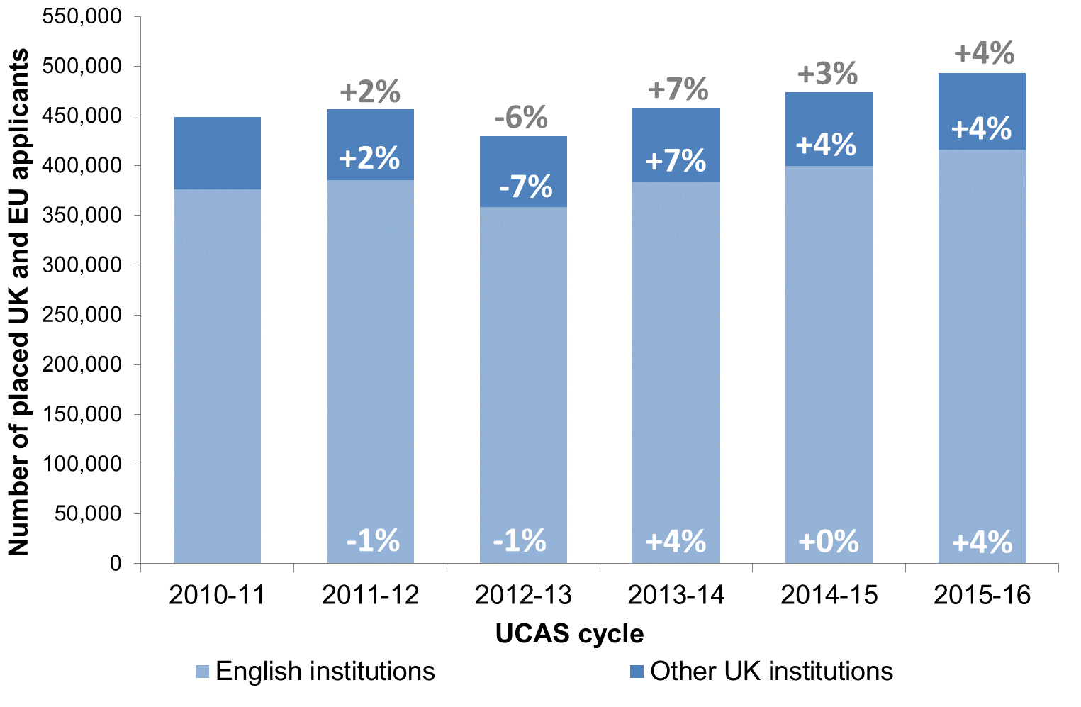
Full-time undergraduate recruitment, 2010 to 2015

Slide 4
UCAS applications to Mathematical Sciences, 2012 to 2016
*Applications to full-time undergraduate study in the UK

Slide 5
UG Entrants to Mathematical Sciences, 2004 to 2014
*Entrants to publicly-funded English higher education institutions. HESA standard registration population.

Slide 6
PG Entrants to Mathematical Sciences, 2004 to 2014
*Entrants to publicly-funded English higher education institutions. HESA standard registration population.

Slide 7
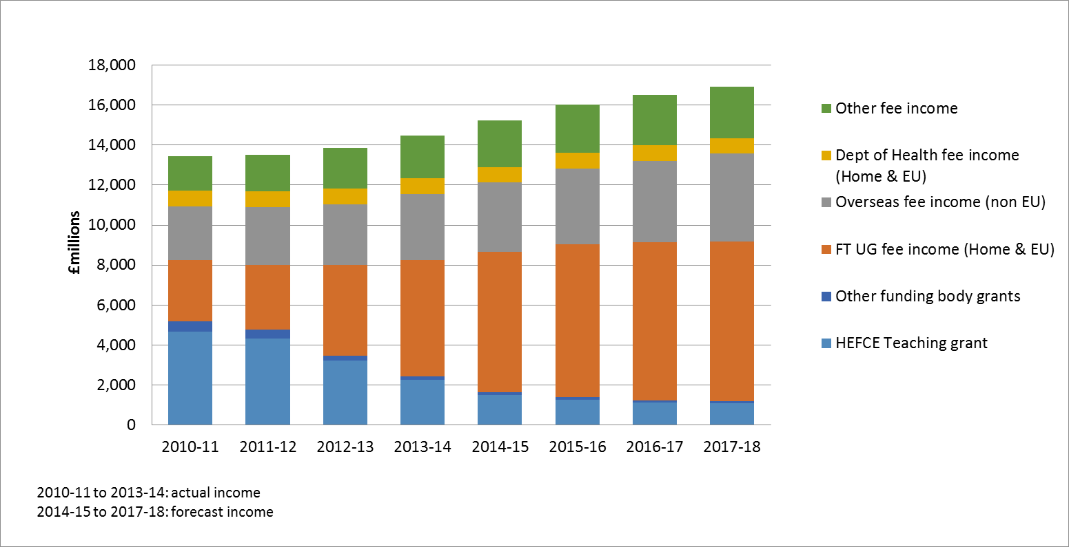
Funding
Teaching income to HEIs – 2010-17
Notes:
1) Funding:
We provide funding to enable investment in, and delivery and improvement of, the student experience. Our funding supports the costs of delivering an excellent teaching and learning environment.
Clearly, funding for teaching has increasingly shifted from the public purse to students, so… [this graph show actual vs forecast figures – a bit old now so 2014-15 is confirmed]
This has driven a renewed focus on protecting the student interest, and supporting student choice and success
However, HEFCE has still allocated around £1,418 million [one thousand, four hundred and eighteen million] to support teaching for 2015-16 (mainly high cost but also targeted)
We have also allocated £733 million in capital and funding for national facilities and initiatives for the academic year 15-16. These funds support the higher education infrastructure to create and sustain the conditions for a world leading HE system, including high-quality buildings, equipment and information technology, which are essential to academic excellence in teaching and research. We recognise that excellent teaching needs a first class environment.
Next steps: [check with Rich – have we received Grant letter published?] We will be looking to consult on principles for future funding, details of this are set to be launched in the Summer.

Slide 8
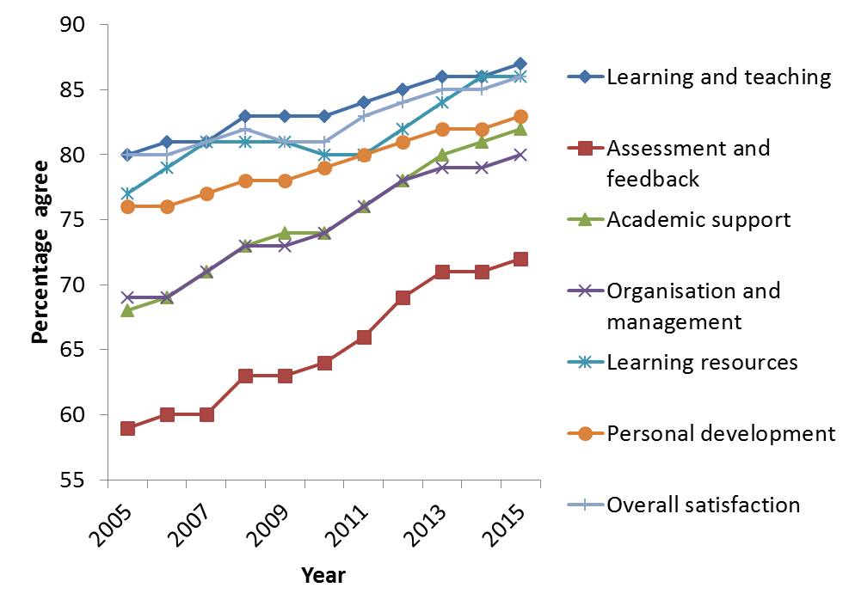
Student satisfaction 2005-2015

Slide 9
Quality, experience and outcomes

Slide 10
New government, new priorities
Notes:
That is why we are developing a new Teaching Excellence Framework. It will identify and
incentivise the highest quality teaching to drive up standards in higher education, deliver
better quality for students and employers and better value for taxpayers. Our aim is to:
place a spotlight on teaching and encourage excellent teaching for all students;
help institutions improve the quality of their teaching by highlighting exemplary practices;
build a culture where it is recognised that teaching has equal status with research within and across HE institutions. Outstanding teachers should enjoy the same professional recognition and opportunities for career and pay progression as great researchers. Research and teaching should be recognised as mutually reinforcing activities;
support and where possible stimulate the sector to help students meet their aspirations by providing them with accessible and clear information to judge teaching quality across courses and disciplines – in the same way they can already compare a department’s research rating;
help employers to identify and recruit graduates with the skills they require by providing better and clearer information about courses and degree outcomes;
recognise those institutions that do the most to welcome students from a range of disadvantaged backgrounds, support them to remain on their courses (such students are often at a higher risk of dropping out) and help them to progress to further study or a high skilled job;
reflect the strength that comes from the diversity of our higher education sector and be flexible in recognising different types of excellence; and
demonstrate that the quality of higher education is a priority in our country, and to provide a clear way for students in England and from other countries to identify institutions that demonstrated this.

Slide 11
TEF Year 1 and Year 2
Year 1 (2016 outcomes for 17-18) – satisfactory QA.
Year 2 (2017 outcomes for 18-19)
TEF technical consultation:
Eligibility
Scope
Evidence
Assessment
Outcomes
Use

Slide 12
Positioning

Slide 13
The future of quality assessment

Slide 14
TEF beyond year 2
“We also want the Council’s assistance with the range of design work needed around future years of the TEF. We would particularly value HEFCE’s advice to consider options around future data requirements and potential future metrics.”

Slide 15
Proposed regulatory architecture
Office for Students
Entry, regulation and exit of all providers
Gateways, information for students, quality, finance, governance
Funding and strategic development (?)
Research UK
Strategic research oversight and accountability
Research Councils
Innovate UK (?)
QR and HEIF (?)
White Paper and TEF technical consultation
Queen’s Speech
2016-17
Legislation (?)
Eligibility
Scope
Evidence
Assessment
Outcomes
Use

Slide 16
PG and Research

Slide 17
Next steps
Spring 2015 - White Paper, TEF Technical Consultation, Queen’s Speech
Autumn 2016 - Government response to TEF Technical Consultation
Winter 2016 - TEF submissions
Spring 2017 – TEF outcomes
2016-17 – Legislation (?)
2017-18 – Shadow bodies (?)
2018-19 – New bodies operating (?)

Slide 18
Thank you for listening

